Slide 1

2D SUDOKU ASSOCIATED BIJECTIONS FOR IMAGE SCRAMBLING
BATCH MEMBERS
AASHIKA PREMKUMAR 119004002
MONISHAA P 119004100
VENNILA K 119004221
VISHALI S 119004228
MENTOR
DR. V. PADMAPRIYA
BECCEC608/MINI PROJECT - 1

Slide 2
INTRODUCTION
Sudoku - 2D number puzzle
Alternate method of matrix representation
Sudoku associated image scrambler
2D associated bijection for image scrambling

Slide 3
MOTIVATION
Development of Digital Communication
Increase in amount of digital data transmission
Secured storage and transmission
Protection from unauthorized usage

Slide 4
OBJECTIVE
To implement Sudoku associated two dimensional
image scrambler

Slide 5
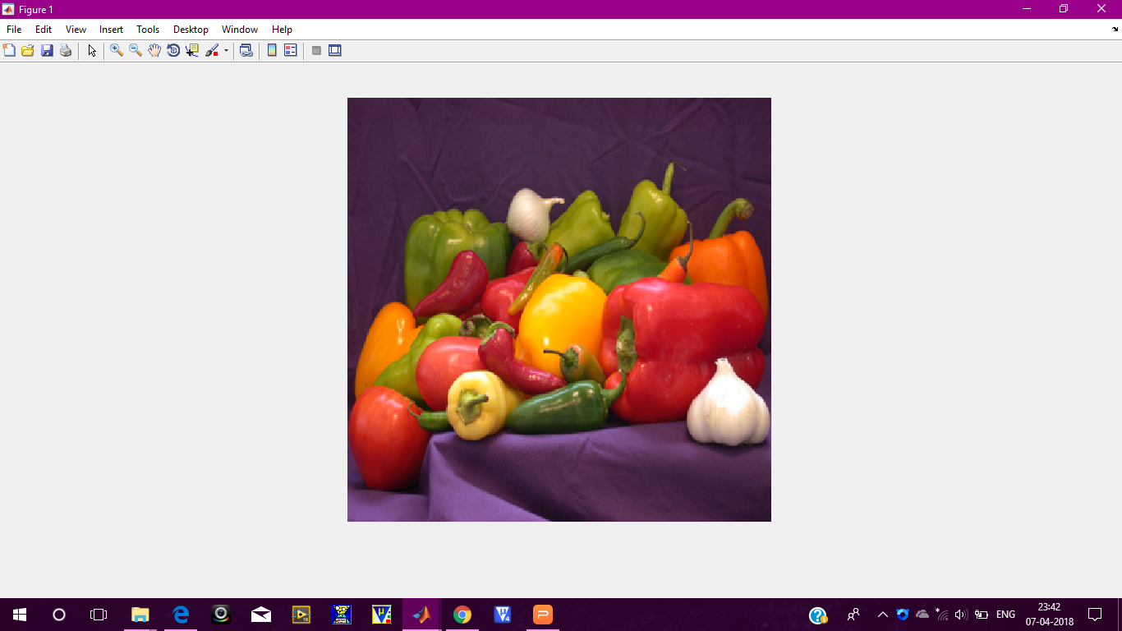

IMAGE SELECTION
Type: RBG image
3 shades (R-G-B) - 8 bit each
24 bit colour image
Pixel range : 0-255
Image size : 360 x 360

Slide 6
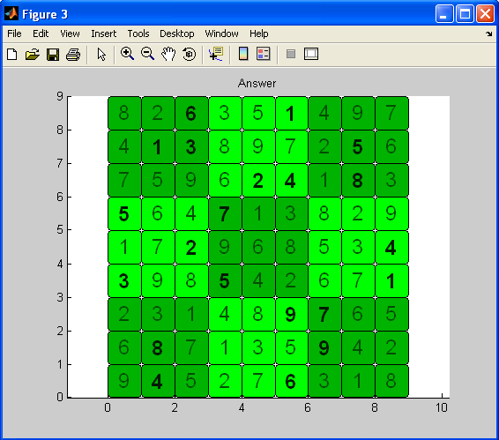
OUTPUT OF SUDUKO GENERATOR

Slide 7
FLOW GRAPH
READ IMAGE
PAIR SELECTION
PAIR PREPARATION
DESCRAMBLING
BITWISE SCRAMBLING
BLOCK SCRAMBLING

Slide 8
ALGORITHM FOR PAIR PREPARATION
NEW_VALUE = OLD_VALUE + PARAMETER * POW(10,DIGITS)
where, PARAMETER can be either row number, column number
or block number

Slide 9
EXAMPLE
ORIGINAL SUDOKO PUZZLE
PARAMETRIC REPRESENTATION - BLOCK DIGIT
8 | 2 | 6 | 3 | 5 | 1 | 4 | 9 | 7
4 | 1 | 3 | 8 | 9 | 7 | 2 | 5 | 6
7 | 5 | 9 | 6 | 2 | 4 | 1 | 8 | 3
5 | 6 | 4 | 7 | 1 | 3 | 8 | 2 | 9
1 | 7 | 2 | 9 | 6 | 8 | 5 | 3 | 4
3 | 9 | 8 | 5 | 4 | 2 | 6 | 7 | 1
2 | 3 | 1 | 4 | 8 | 9 | 7 | 6 | 5
6 | 8 | 7 | 1 | 3 | 5 | 9 | 4 | 2
9 | 4 | 5 | 2 | 7 | 6 | 3 | 1 | 8
18 | 12 | 16 | 43 | 45 | 41 | 74 | 79 | 77
14 | 11 | 13 | 48 | 49 | 47 | 72 | 75 | 76
17 | 15 | 19 | 46 | 42 | 44 | 71 | 78 | 73
25 | 26 | 24 | 57 | 51 | 53 | 88 | 82 | 89
21 | 27 | 22 | 59 | 56 | 58 | 85 | 83 | 84
23 | 29 | 28 | 55 | 54 | 52 | 86 | 87 | 81
32 | 33 | 31 | 64 | 68 | 69 | 97 | 96 | 95
36 | 38 | 37 | 61 | 63 | 65 | 99 | 94 | 92
39 | 34 | 35 | 62 | 67 | 66 | 93 | 91 | 98

Slide 10
BLOCK SCRAMBLING ALGORITHM
Split the original image into red, green and blue channels
Convert the image into blocks using mat2cell( ) & name it as CA_1
Extract a value from Parametric Array & Note its row & column as (R1,C1)
Find that value in Fixed Array & Note its row & column as (R2,C2)
Now place BLOCK (R1,C1) of CA_1 to (R2,C2) of CA_2
Repeat the above process for 'N' times, N - no. of blocks

Slide 11
1 | 2 | 3 | 4 | 5 | 6 | 7 | 8 | 9
10 | 11 | 12 | 13 | 14 | 15 | 16 | 17 | 18
19 | 20 | 21 | 22 | 23 | 24 | 25 | 26 | 27
28 | 29 | 30 | 31 | 32 | 33 | 34 | 35 | 36
37 | 38 | 39 | 40 | 41 | 42 | 43 | 44 | 45
46 | 47 | 48 | 49 | 50 | 51 | 52 | 53 | 54
55 | 56 | 57 | 58 | 59 | 60 | 61 | 62 | 63
64 | 65 | 66 | 67 | 68 | 69 | 70 | 71 | 72
73 | 74 | 75 | 76 | 77 | 78 | 79 | 80 | 81
11 | 2 | 12 | 10 | 20 | 3 | 19 | 1 | 21
37 | 39 | 46 | 30 | 28 | 29 | 38 | 48 | 47
57 | 55 | 56 | 74 | 75 | 64 | 66 | 65 | 73
6 | 23 | 4 | 24 | 5 | 22 | 15 | 13 | 14
32 | 61 | 33 | 50 | 49 | 41 | 31 | 42 | 40
67 | 76 | 68 | 58 | 69 | 78 | 77 | 59 | 60
25 | 16 | 27 | 7 | 17 | 18 | 9 | 26 | 8
54 | 35 | 44 | 45 | 43 | 52 | 53 | 34 | 36
80 | 72 | 79 | 71 | 63 | 62 | 61 | 81 | 70
ORIGINAL
IMAGE
SCRAMBLED
IMAGE
18 | 12 | 16 | 43 | 45 | 41 | 74 | 79 | 77
14 | 11 | 13 | 48 | 49 | 47 | 72 | 75 | 76
17 | 15 | 19 | 46 | 42 | 44 | 71 | 78 | 73
25 | 26 | 24 | 57 | 51 | 53 | 88 | 82 | 89
21 | 27 | 22 | 59 | 56 | 58 | 85 | 83 | 84
23 | 29 | 28 | 55 | 54 | 52 | 86 | 87 | 81
32 | 33 | 31 | 64 | 68 | 69 | 97 | 96 | 95
36 | 38 | 37 | 61 | 63 | 65 | 99 | 94 | 92
39 | 34 | 35 | 62 | 67 | 66 | 93 | 91 | 98
11 | 12 | 13 | 14 | 15 | 16 | 17 | 18 | 19
21 | 22 | 23 | 24 | 25 | 26 | 27 | 28 | 29
31 | 32 | 33 | 34 | 35 | 36 | 37 | 38 | 39
41 | 42 | 43 | 44 | 45 | 46 | 47 | 48 | 49
51 | 52 | 53 | 54 | 55 | 56 | 57 | 58 | 59
61 | 62 | 63 | 64 | 65 | 66 | 67 | 68 | 69
71 | 72 | 73 | 74 | 75 | 76 | 77 | 78 | 79
81 | 82 | 83 | 84 | 85 | 86 | 87 | 88 | 89
91 | 92 | 93 | 94 | 95 | 96 | 97 | 98 | 99
BLOCK
DIGIT
ROW
COLUMN

Slide 12
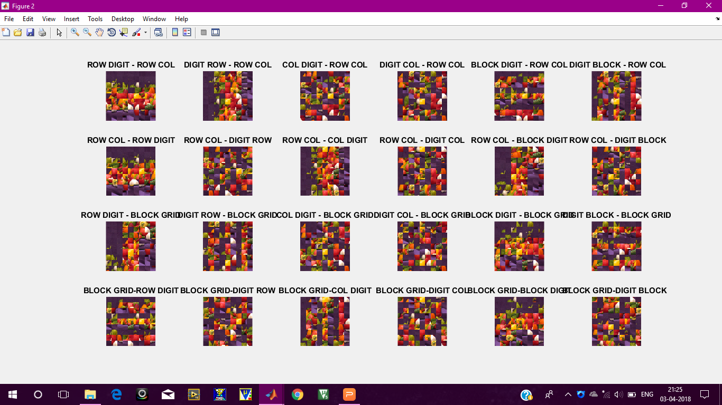
TOTAL
24
MAPPING

Slide 13
BITWISE ALGORITHM
Flatten the scrambled image into a 1D array by connecting each row together - use horzcat( ) function
Array length will be P, where P - no of pixels
Create a column having its binary value - use de2bi( ) function
This gives a 2D array of size 8 X P
Reshape it accordingly - use reshape( ) function

Slide 14
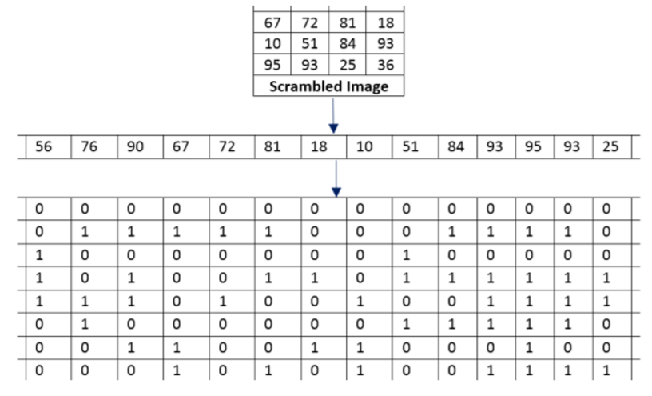
BIT SCRAMBLING MATRIX GENERATION

Slide 15
BITWISE ALGORITHM
Perform the same puzzle pair scrambling to this 2D array
Reshape it into 8 X P - use reshape( ) function
Extract each column and convert this binary values to decimal - use num2str( ) & bin2dec( ) function
This decimal corresponds to new pixel values

Slide 16
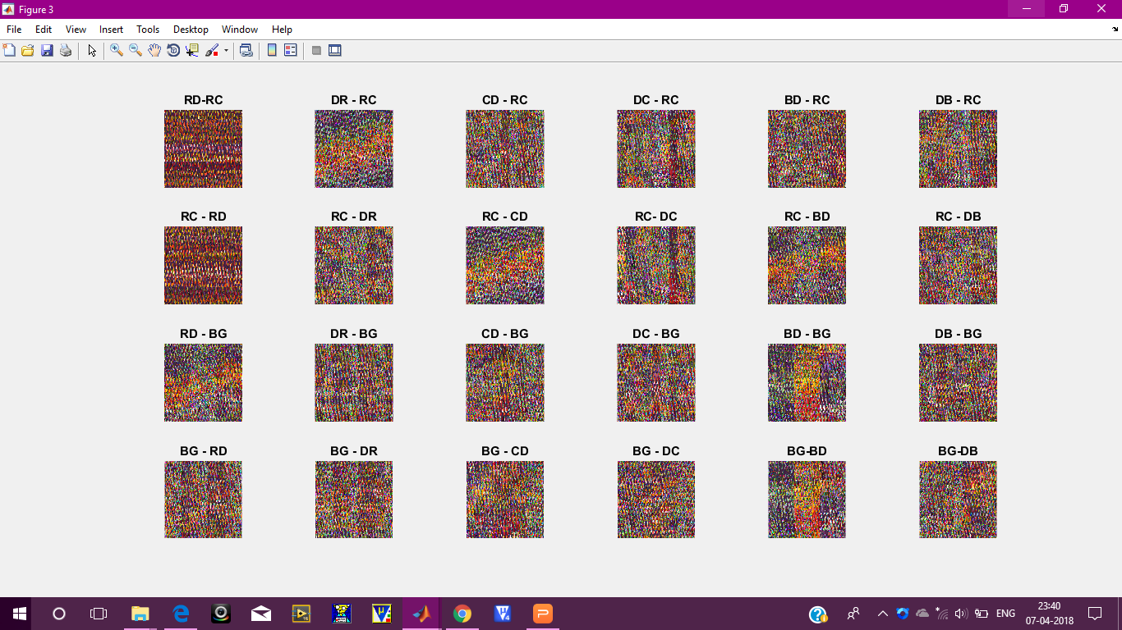
BITWISE OUTPUT

Slide 17
DESCRAMBLING
To descramble the image to its original form, one must simply exchange roles of prepared Sudoku puzzles and reverse the scrambling steps .This will successfully restore the image.

Slide 18
CORRELATION RESULTS
COLOR | RED | GREEN | BLUE
ROW DIGIT - ROW COLUMN FORWARD MAPPING | 0.0495 | 0.0246 | 0.0283

Slide 19
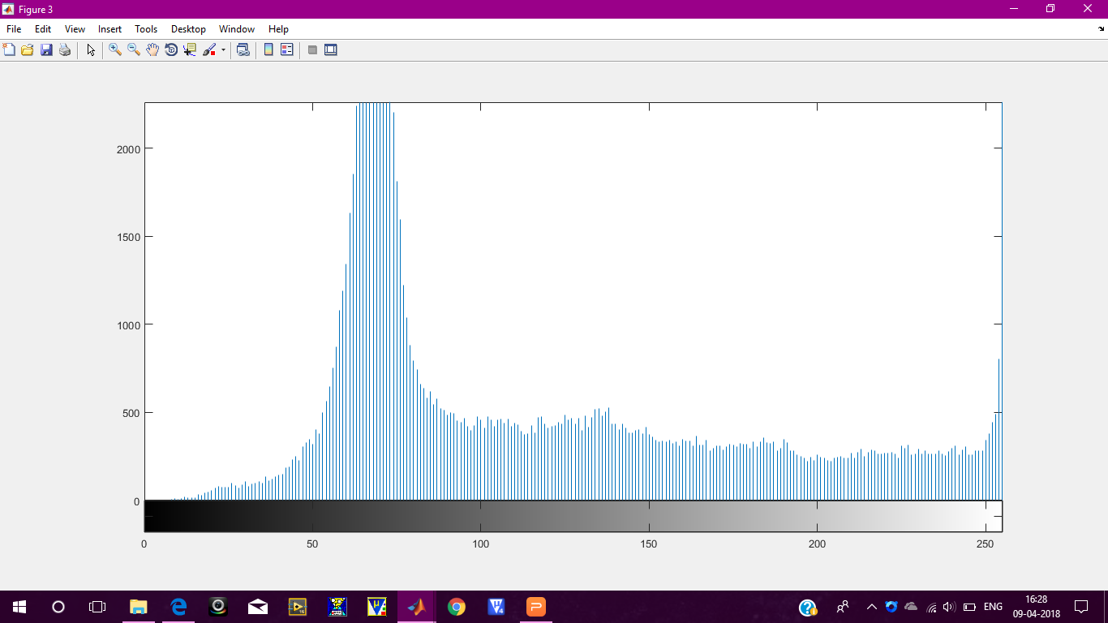
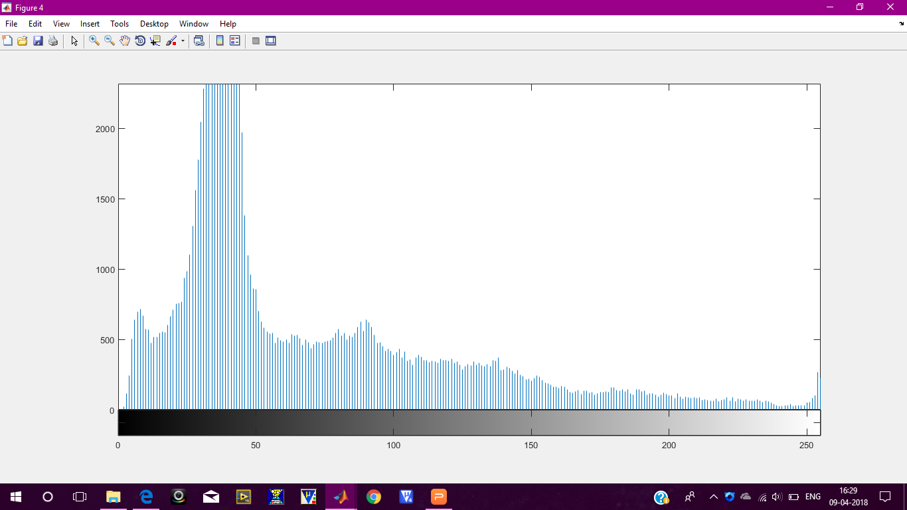
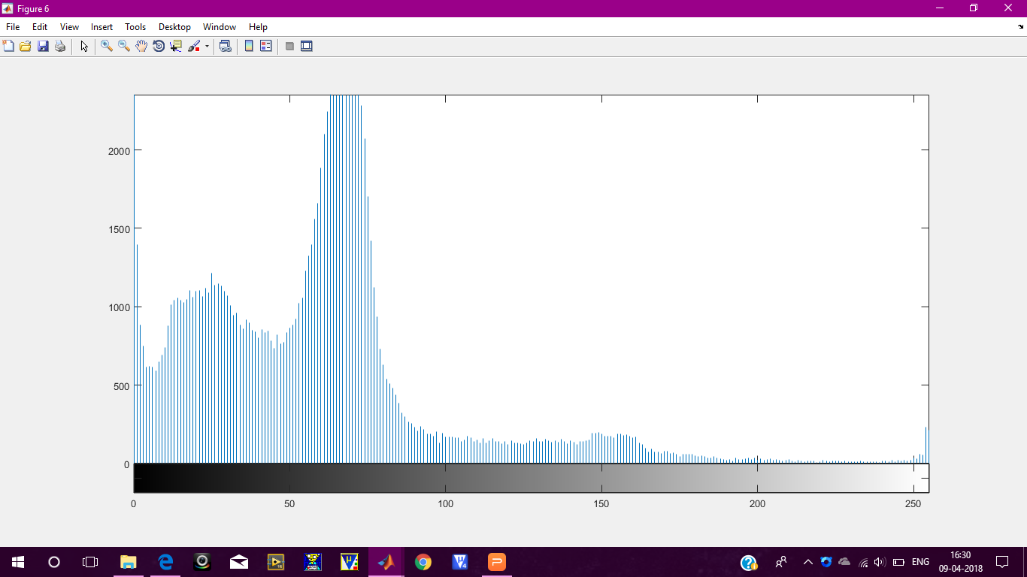
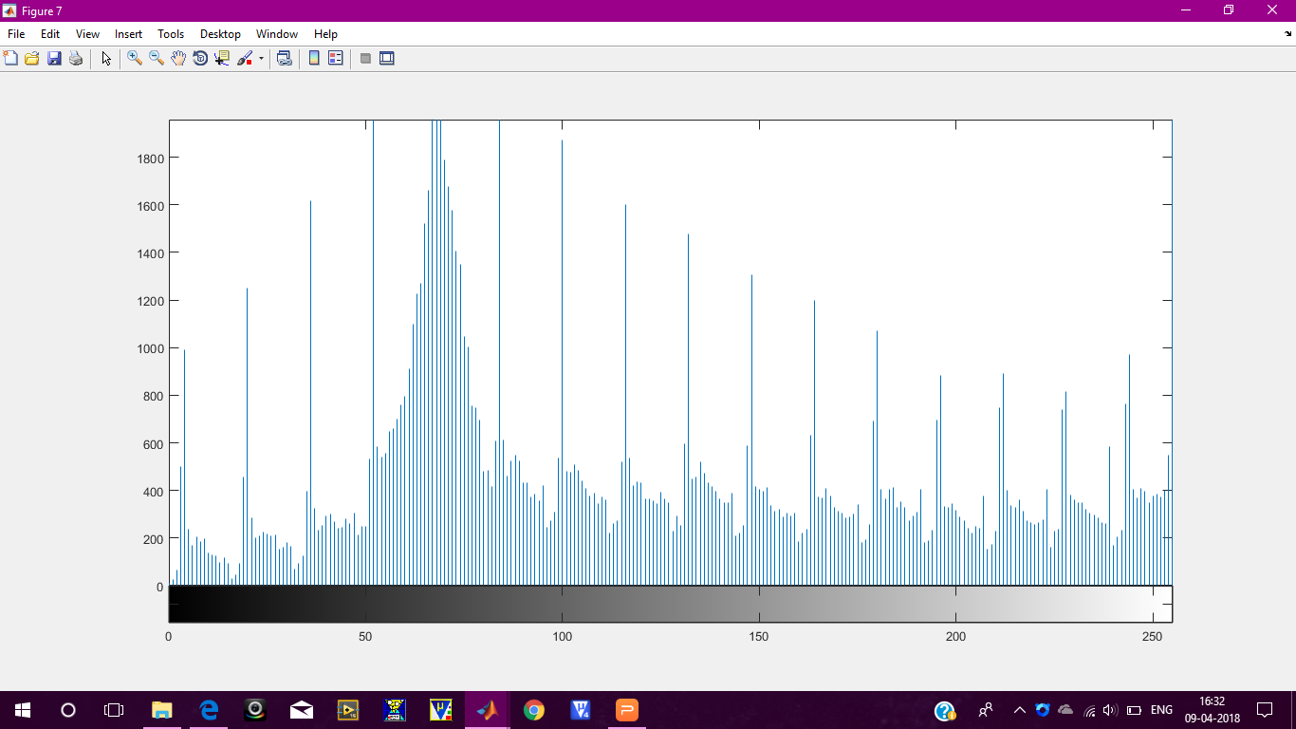
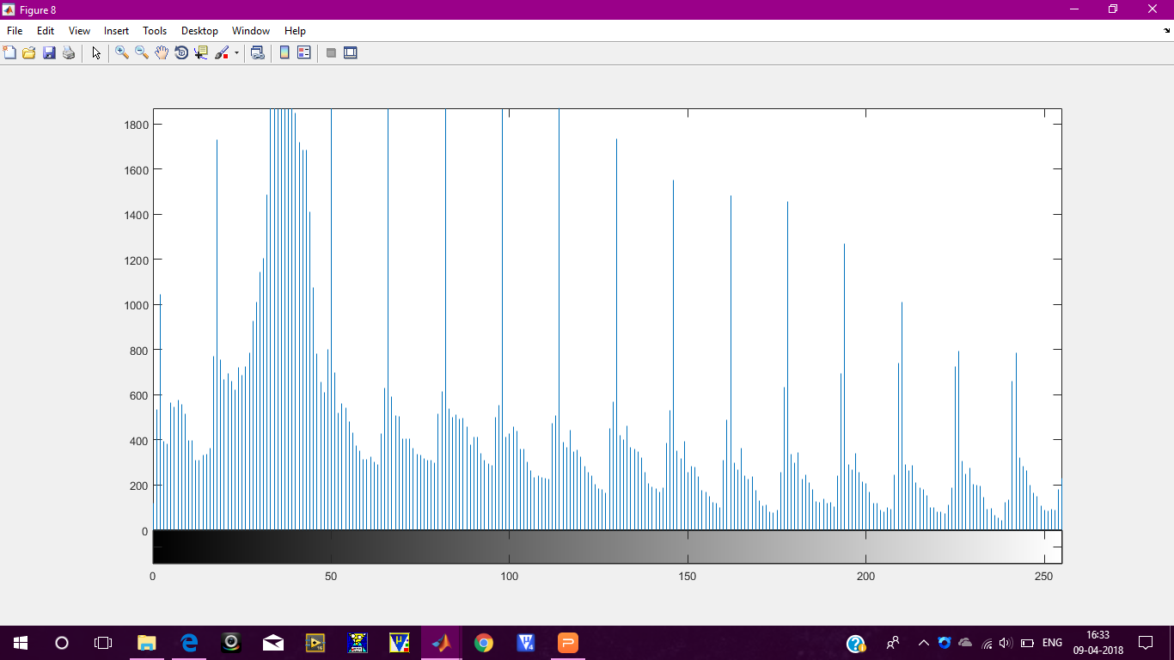
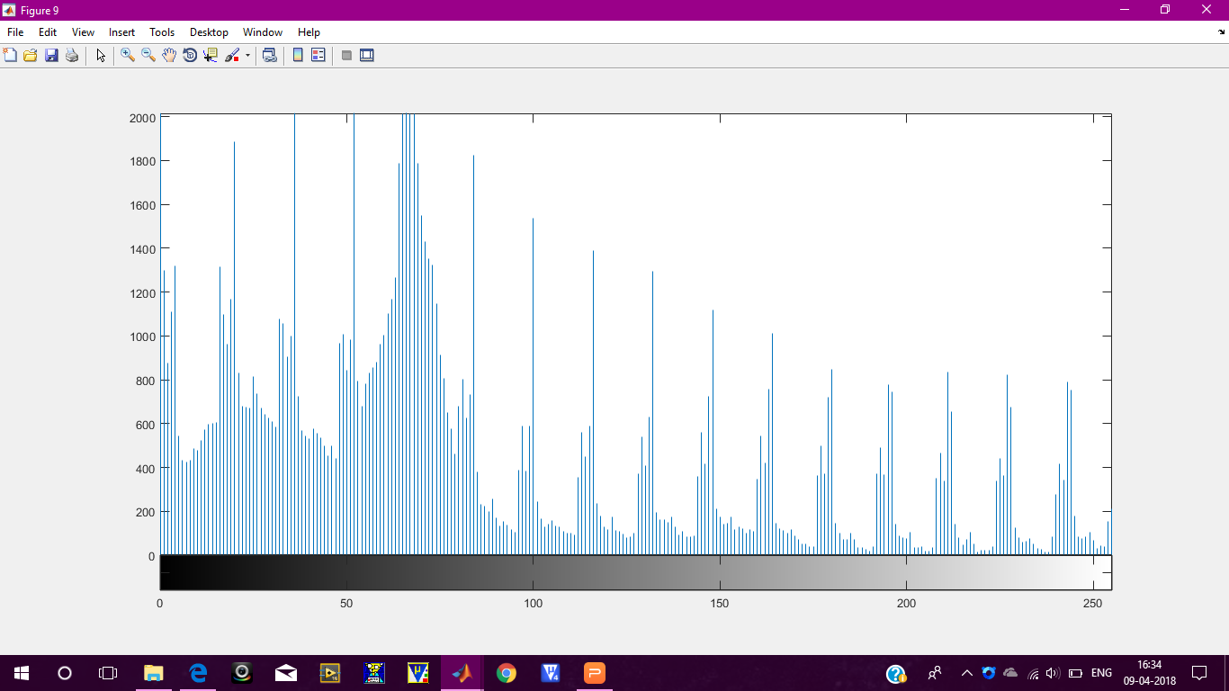
HISTOGRAM OUTPUT
RED
GREEN
BLUE
ORIGINAL
IMAGE
SCRAMB-LED
IMAGE

Slide 20
ENTROPY COMPARISION FOR BITWISE - FORWARD MAPPING METHODOLOGY
MAPPING | ROW COLUMN
ROW DIGIT | 7.3873
DIGIT ROW | 7.6278
COLUMN DIGIT | 7.6254
DIGIT COLUMN | 7.6285
BLOCK DIGIT | 7.6294
DIGIT BLOCK | 7.6280

Slide 21
COMPARISON OF VARIOUS IMAGE SCRAMBLING TECHNIQUES
PARAMETER | RUBIKS CUBE | ARNOLD’S CAT | SUDOKU PUZZLE
BASIC UNIT | PIXEL/BLOCK | PIXEL | BLOCK
SCRAMBLING TIMES | ANY NO OF TIMES | FIXED | ANY NO OF TIMES
AREA | ANY TYPE | SQUARE | SQUARE
REASSEMBLY | BY REVERSING | BY RE-SCRAMBLING | BY REVERSING

Slide 22
APPLICATIONS OF IMAGE SCRAMBLING
Scrambled images are used to improve image security.
This technique is most widely used for military information as this avoids decoding of sensitive information.
It is also used to encrypt medical images to protect patients’ privacy.
Image scrambling is necessary for secure end to end data transmission.

Slide 23
REFERENCE PAPERS
A Comprehensive Survey on Image Scrambling Techniques - Prarthana Madan Modak1, Dr. Vijaykumar Pawar
2D Sudoku associated bijections for image scrambling - Yue Wua, Yicong Zhoub, Sos Agaianc, Joseph P. Noonana
Image Scrambling Methods for Image Hiding: A Survey Reema Rhine #1, Nikhila T Bhuvan*2

